Slide 1
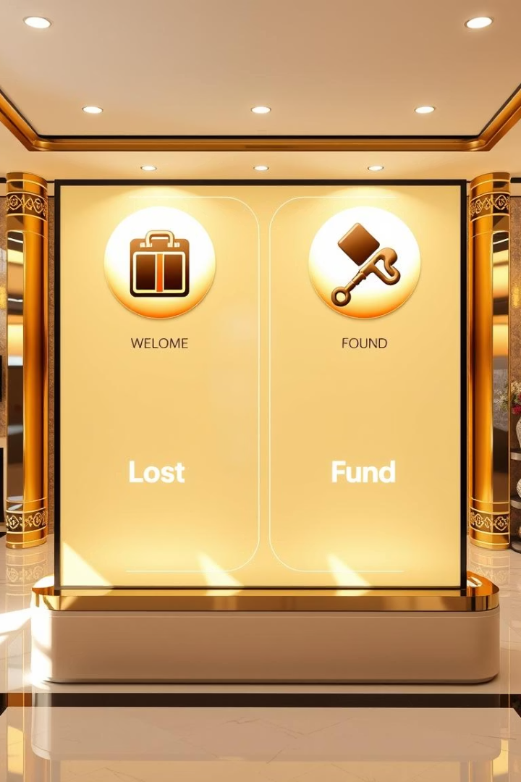

Virtual Lost and Found Platform
Mini Project by Ashok (2401730159), Anuj (2401730177), Tanuja Kumari (2401730289), and Gopi Prasad (2401730181).
by Ashok Dhariwal

Slide 2
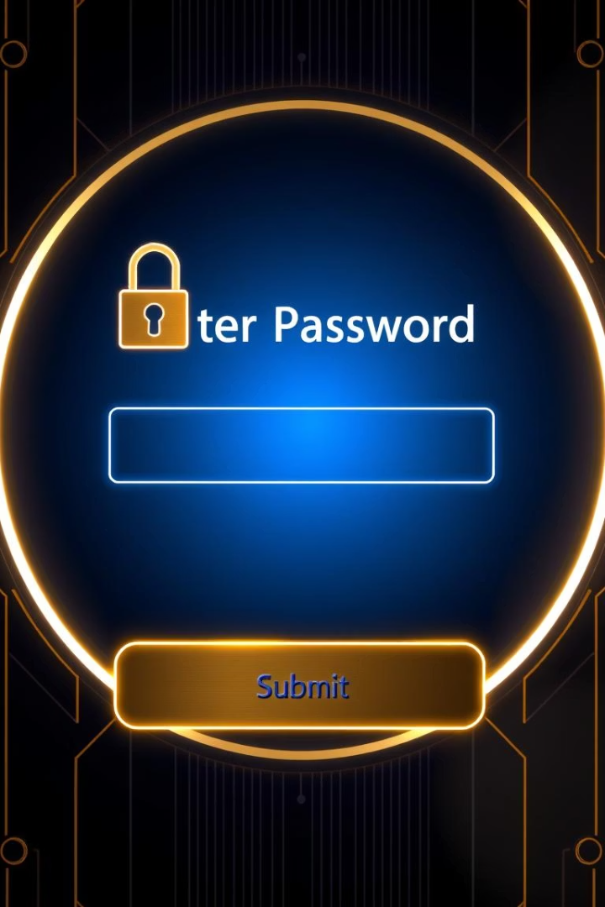
Secure Registration and Authentication
User Registration
Email, password setup, and verification.
Secure Authentication
Password hashing and encrypted login process.
Role-based Access
Different permissions for admin and users.
Data Encryption
HTTPS and AES-256 protect data in transit and at rest.

Slide 3
Reporting Lost Items
Detailed Descriptions
Location and Date
Image Upload
Item name, brand, color, size
Input address, landmark, or GPS coordinates
Supports JPEG, PNG(up to 5MB) to aid identification.
Category selection for easy sorting
Date and time picker for loss details

Slide 4
Reporting Found Items
Input Fields
Found Date & Contact
Description, category, and location
Specify when and where item was found
Similar to lost item reporting
Include contact info for quick returns

Slide 5
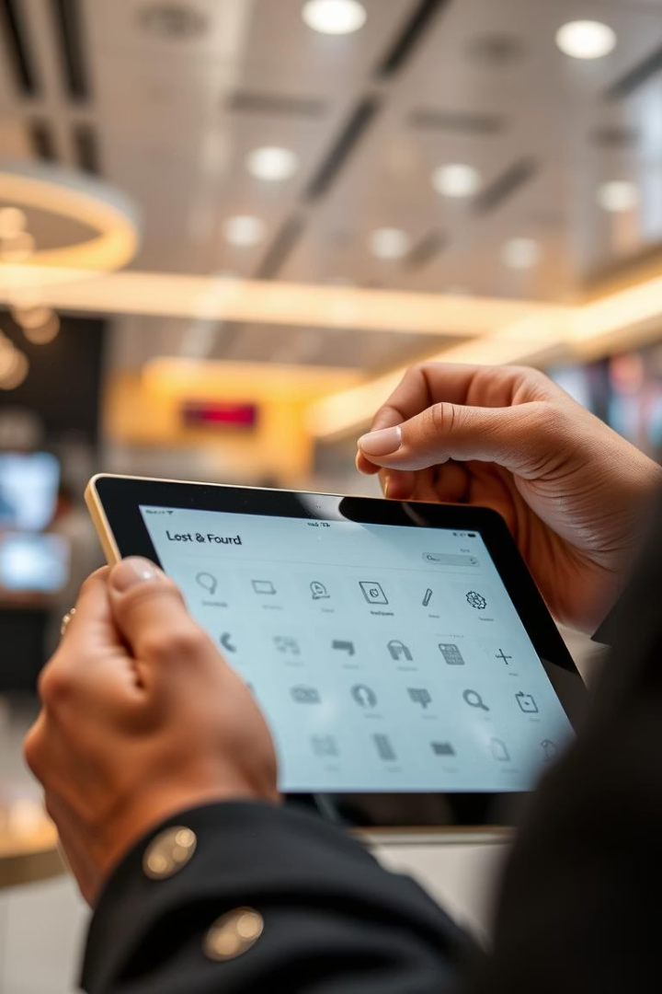
Item Search Functionality
Keyword Search
Filtering Options
Search across all item fields with ease.
Filter by category, date range, and location radius.
Sorting Choices
Sort results by relevance, date, or distance.

Slide 6
Real-time Notifications
Matching Algorithm
Push Notifications
Custom Preferences
Automatically links lost and found reports.
Email, SMS, and in-app alerts for matches.
Users control notification frequency and item types.

Slide 7

System Architecture
Database
PostgreSQL with JSONB for flexible data storage.
API Endpoints
RESTful design secured with JWT tokens.
Cloud Infrastructure
Scalable hosting on AWS, Azure, or Google Cloud.
Performance
Average query response time under 200ms.

Slide 8

Conclusion and Future Enhancements
Platform Recap
Future Features
Secure registration, item reporting, search, and notifications.
AI-powered matching and integrated maps for items.
User Feedback
Mechanisms planned to continuously improve experience.

Slide 9

Thank You
We appreciate your attention to our Virtual Lost and Found Platform project.

